Slide 1
Zzznacks
Katherine White

Slide 2
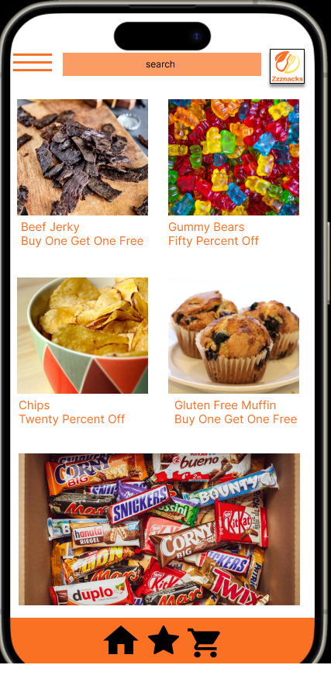
Project overview
The product:
The app is a for a snack shop that is located in an amusement park. The app allows users to order and pay for their snacks ahead of time so they can pick it up quickly and allow them time more time to enjoy the rest of the amusement park while earning reward points to use to lower their total cost.
Project duration:
September 2023 – December 2023

Slide 3
Project overview
The problem:
Users need to pick up snacks quickly, while saving money. They also need to have snack options for people with allergies.
The goal:
I would like the user to be able to search for a variety of snack, choose items to add to a shopping cart, utilize reward points for discounts, choose a pick-up time, and pay online for their order.

Slide 4
Project overview
My role:
UX researcher and UX designer
Responsibilities:
Research user needs and problems
Ideate solutions to their needs and problems
Create a user journey
Create personas
Complete a competitive analysis
Create wireframes
Build low and high fidelity prototypes

Slide 5
User research
Personas
Problem statements
User journey maps
Understanding
the user

Slide 6
User research: summary
I researched the demographics of people that go to amusement parks to find out who my customers would be for the snack shop located within the park. The research confirmed my assumption that children, teens, and families are the primary attendees. I also researched most common food allergies. It confirmed my knowledge that gluten, dairy, and nuts were most common allergies but also informed me that there are a high number of people with egg allergies.

Slide 7
User research: pain points
1
2
3
4
Lack of time
Lack of snack variety
Lack of accessible allergy appropriate sncks.
Need to save money
My app is used for a snack shop that is located in an amusement park. Users will want to grab a snack quickly so they can go ahead and get in line for rides or attractions quickly. This will encourage my app to help reduce shopping time by preordering.
Families who have many members will not all want the same type of snack. This will encourage the app to include filters to different snack categories to meet the various wants of each member.
People who have food allergies will need snack options that wont make them sick. This will encourage the app to highlight the foods that are safe for the users to eat.
People want to budget and get the most out of their money. This will encourage the app to highlight sales and to create a loyatly program that helps frequent shoppers save more money.

Slide 8
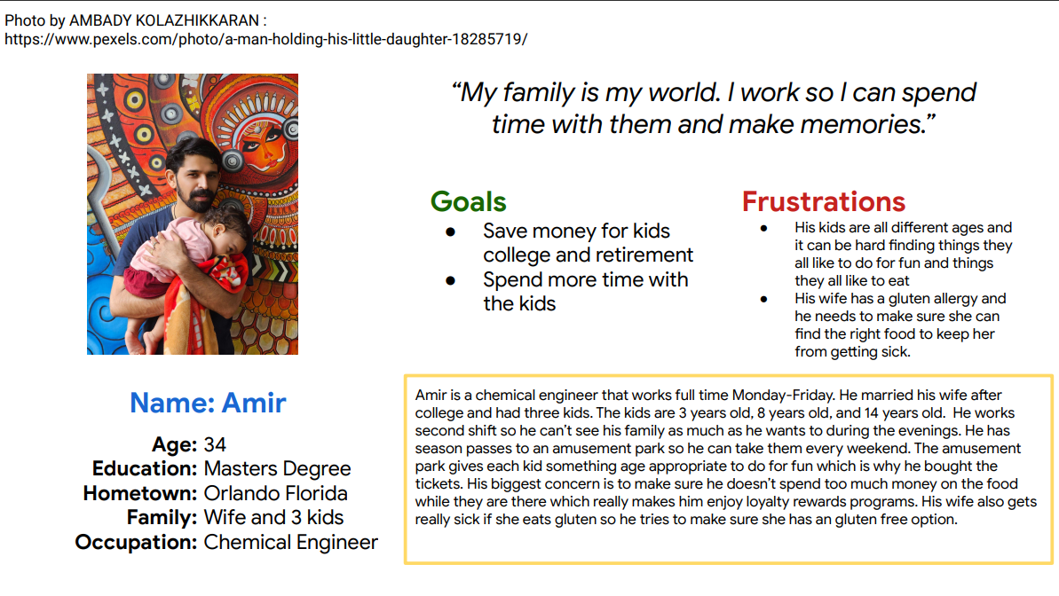
Persona: Amir
Problem statement:
Amir is a husband and father who needs to save money on snacks and have gluten free options for his wife
because he wants to make memories with his family at the amusement park, make sure everyone is fed while staying in budget.

Slide 9
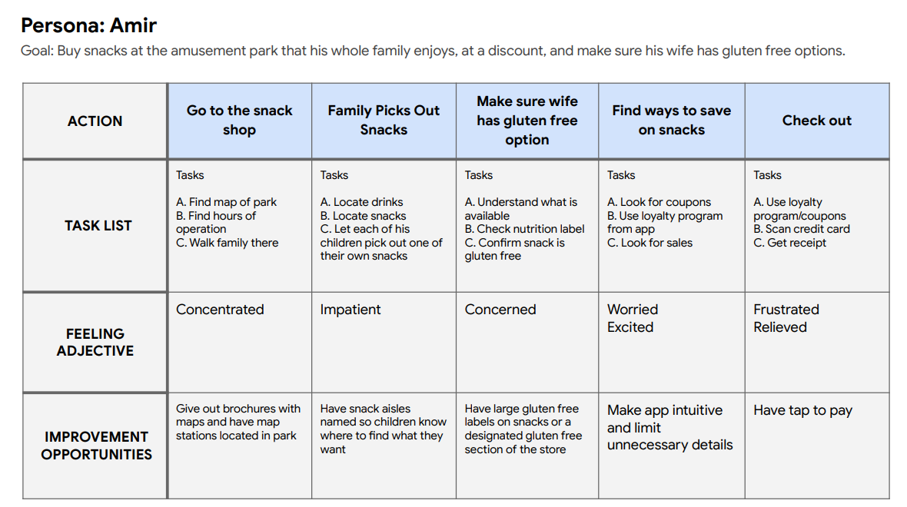
User journey map
My goal was to think like Amir and take into consideration the needs of his children and wife as well. His need to provide for his family will make him have different emotions and I wanted to alleviate him of any frustrations or delays to make the ordering process efficient. That way he can spend more time with his family and have fun.

Slide 10
Paper wireframes
Digital wireframes
Low-fidelity prototype
Usability studies
Starting
the design

Slide 11
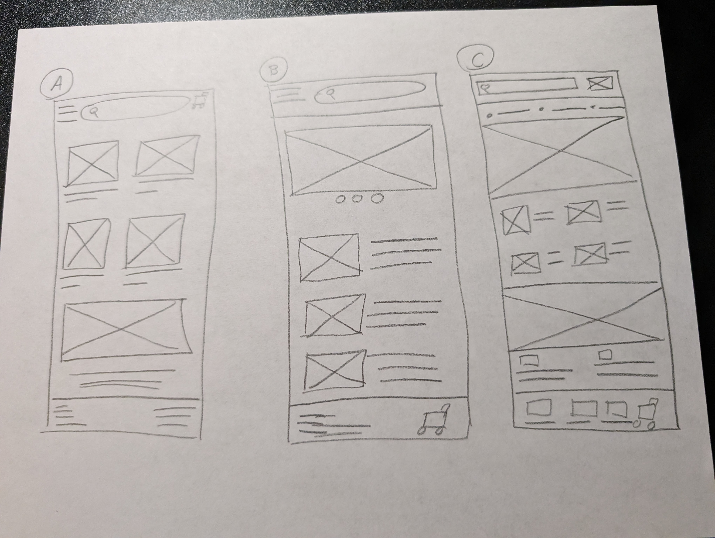
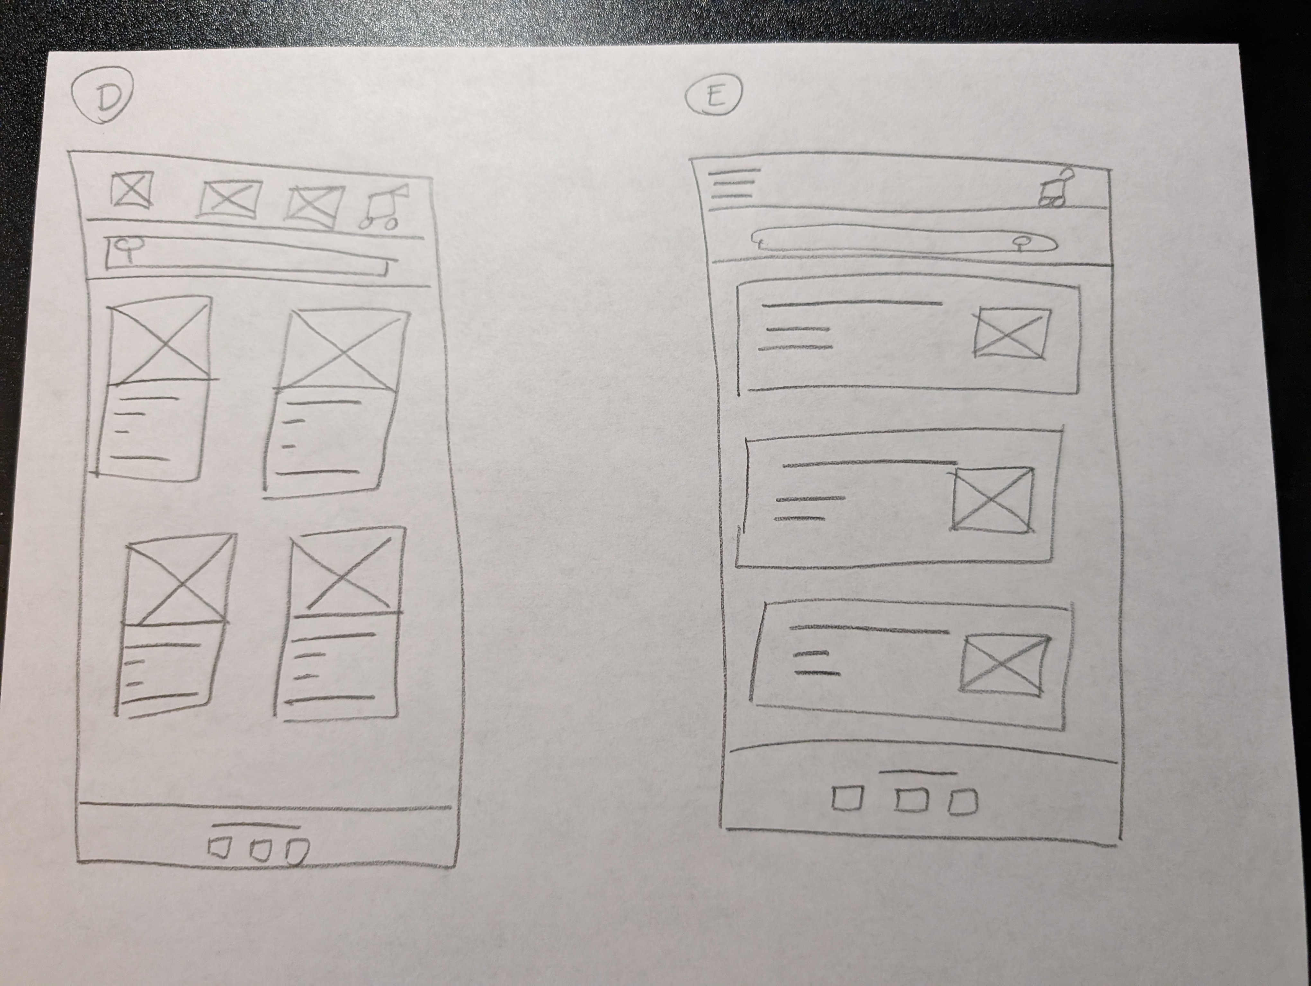
Paper wireframes
It was nice to be able to use pencil and paper to quickly brainstorm ideas without costing to much. I would invest in stencils if I did it as a career to make the wireframes more clean. I ended up choosing the first option because it allowed the user to see more visuals on the homepage and access more text later on for items they specifically choose to learn more about.

Slide 12
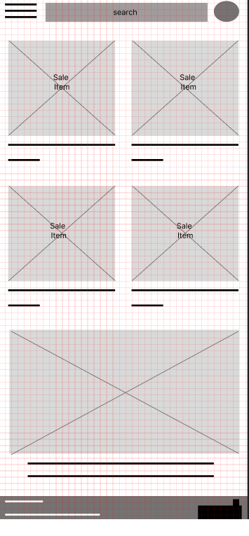
Digital wireframes
The navigation link and search bar allows the user to search for snacks quickly.
I wanted the homepage to display items that were on sale to help users save money. I also wanted to add navigation and search bars so they can filter snacks quickly to find what they are looking for while inside the amusement park. The homepage also highlights gluten free options making it easeier for users with food allergies to access the products they need.
The picture shows gluten free options available for users with allergies.

Slide 13
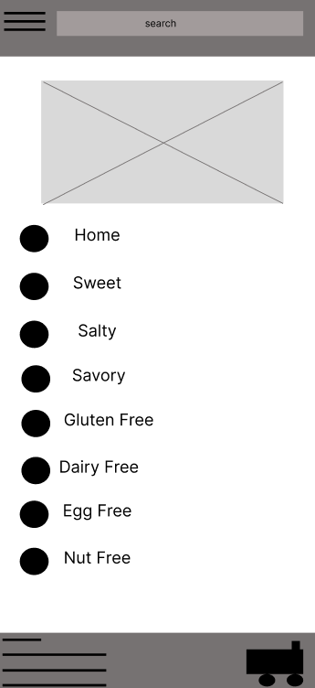
Digital wireframes
This page allowed me to reach the goal of minimizing the amount of time users have to use to search for snacks. It allows them to quickly filter snacks based of a taste and allergy category so they aren’t bogged down with so many options of snack they wouldn’t want.
The navigation menu allows users to filter snacks based off of tastes and allergy and find what they want quickly.
The cart icon takes user to the page that allows them to see what they want to order.

Slide 14
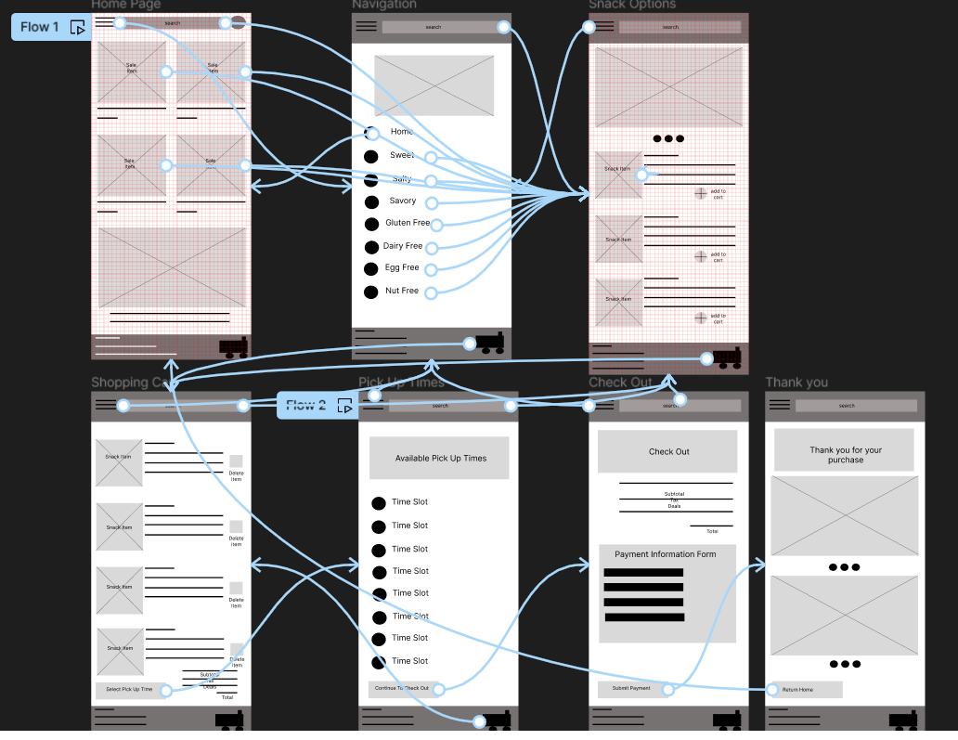
Low-fidelity prototype
https://www.figma.com/proto/euqAH6ga8fcOtWhMeNcYBZ/Untitled?type=design&node-id=1-2&t=FUa4lWT249t0gkfF-1&scaling=scale-down&page-id=0%3A1&starting-point-node-id=1%3A2&mode=design

Slide 15
Usability study: findings
Write a short introduction to the usability studies you conducted and your findings.
Round 1 findings
Round 2 findings
1
Home button was needed in app.
1
Add to cart buttons need to be bigger.
2
Submission buttons needed to be centered.
2
The footer need icons for navigation.
3
Footer was loading off screen in presentation.
3
A call to action icon was needed for pickup times.

Slide 16
Refining
the design
Mockups
High-fidelity prototype
Accessibility

Slide 17
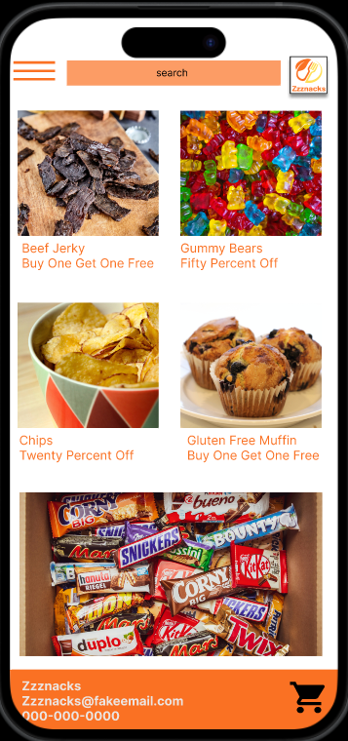
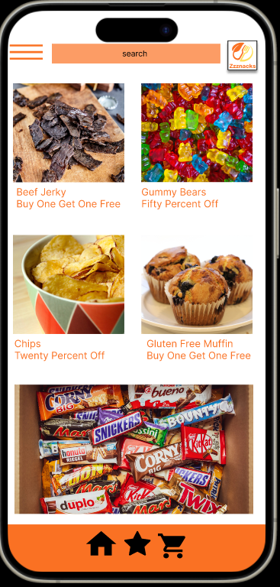
Mockups
Before usability study
After usability study
The footer on my first screen was more like a desktop footer. I added icons as another way to navigate to important parts of the app to make it easier for users.

Slide 18
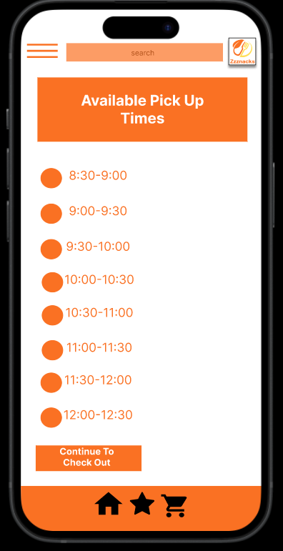
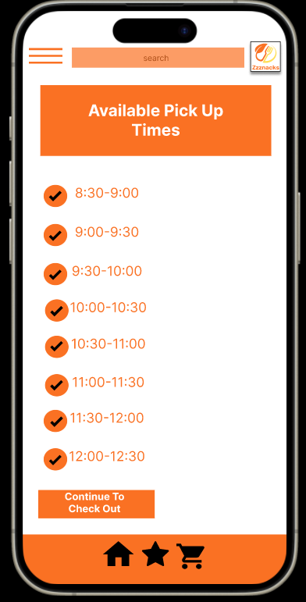
Mockups
Before usability study
After usability study
I added checkmarks beside the times to indicate to users that they can click to select the time they want.

Slide 19
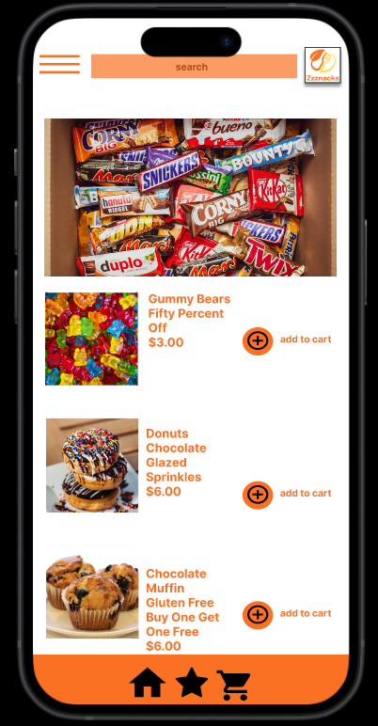
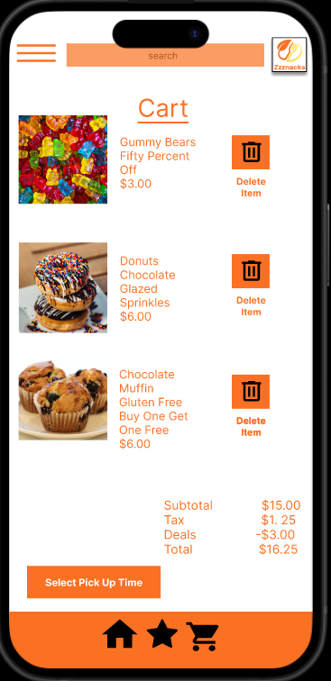
Mockups

Slide 20
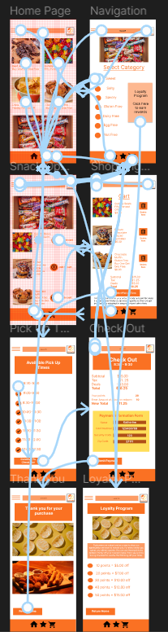
High-fidelity prototype
https://www.figma.com/proto/euqAH6ga8fcOtWhMeNcYBZ/Untitled?type=design&node-id=137-4&t=khk4cEtyi8rgvmEg-1&scaling=scale-down&page-id=137%3A2&mode=design

Slide 21
Accessibility considerations
1
2
3
I applied high contrasting colors for people with visibilty needs.
I applied larger icons to make it easier to press for people with motor ability needs.
I choose not to use multiple fonts or onest that include serifs or impsoter letter shapes to increase readability.

Slide 22
Going forward
Takeaways
Next steps

Slide 23
Takeaways
Impact:
“Was able to move about the site with ease.”
“Love the colors. They really stand out and seem inviting.”
What I learned:
I learned that there are many steps that go into the design process. Starting with the user in mind helps designers pin point products, understand the user journey, and make products accesible to all. Empathizing with your customer and completing competitive advatanges will help designers develop products that can better meet users needs.

Slide 24
Next steps
1
2
3
I would do more research on visual design so I can learn how to make the app look more appealing and professional.
I would have a variety of user use my app so I can see areas that need to be improved and areas that users like the most.
I would include more product pages for the other categories of snack options so a user can view salty, savory, and not just sweet.

Slide 25
Citations
Beef Jerky- https://unsplash.com/photos/a-wood-cutting-board-with-brown-objects-on-it-nlBelQEqwZQ
Gummy Bears- https://unsplash.com/photos/yellow-green-and-red-plastic-beads-LU_fCezP9-o
Chip Bowl- https://unsplash.com/photos/potato-chips-in-bowl-ONQ86GlHs3c
Muffin- https://unsplash.com/photos/brown-cupcakes-on-white-ceramic-plate-5RQffqRkmWQ
Candy bars- https://unsplash.com/photos/orange-and-red-plastic-pack-mGP8gyGb8zY
Donuts- https://unsplash.com/photos/doughnut-with-toppings-q54Oxq44MZs
Chips with yellow background- https://unsplash.com/photos/brown-and-white-round-cookies-7cRBG4nQtKs
Chicken nuggets and mozzarella sticks- https://unsplash.com/photos/fried-food-on-brown-wooden-tray-SQ1vUOxSIZc

Slide 26
Insert a few sentences summarizing the next steps you would take with this project and why. Feel free to organize next steps in a bullet point list.
Let’s connect!
My name is Katherine White and if you would like to collaborate in the future then you can reach me at krwhite5@my.waketech.edu

Slide 27
Thank you!

